Slide 1



DBMS
LAB
PROJECT
Library Management System
Presented by Rahul & Deepankar

Slide 2

﻿MEET THE GROUP
Rahul Kumar Singh
CSE AIML
Roll No.-14
Deepankar Samal
CSE AIML
Roll No.-23

Slide 3

﻿TABLE OF CONTENTS
1
Introduction
2
Objective
3
Problems that LMS Solved
4
Software Used
5
Tools Used
System Implementation
6
7
Future Application
8
Conclusion

Slide 4

INTRODUCTION
A Library Management System (LMS) is a vital tool for efficient organization and administration of libraries.
This software solution streamlines tasks like cataloging, circulation, patron management, and inventory control.
It enhances user experience, simplifies staff operations, and ensures optimal resource utilization in libraries of all sizes.

Slide 5
OBJECTIVE
The objective of a Library Management System is to efficiently organize, catalog, and manage library resources, including books, periodicals, and digital materials. It aims to streamline borrowing and returning processes, track inventory, provide accurate search and retrieval, and generate reports for library staff to enhance overall library operations and user experience.

Slide 6
PROBLEMS THAT LMS SOLVED
A Library Management System resolves multiple challenges, including efficient cataloging and tracking of books, reducing manual data entry errors, streamlining patron checkouts and returns, managing overdue fines, providing real-time availability information, and facilitating comprehensive reporting for better resource utilization and informed decision-making.

Slide 7

SOFTWARE
USED
1
Visual Studio Code (Python)
2
MySQL
3
XAMPP

Slide 8
TOOLS USED
1
Python ( GUI ) - Interact with graphical compnents
2
Using Tkinter in Python to make use GUI in Python
3
Database - MySQL
4
4
Imported mysql.connecter to connect MySQL database to python file

Slide 9
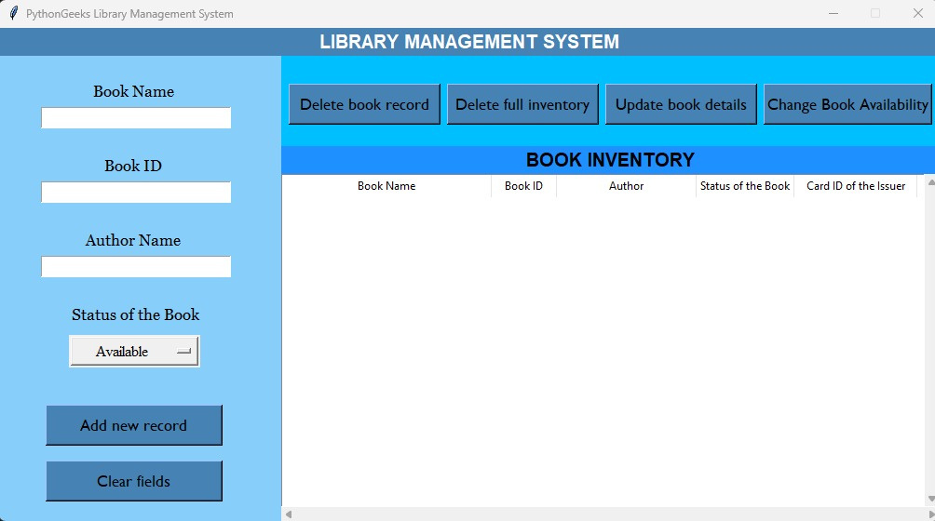
SYSTEM IMPLEMENTATION
Screenshot of our LMS Project

Slide 10
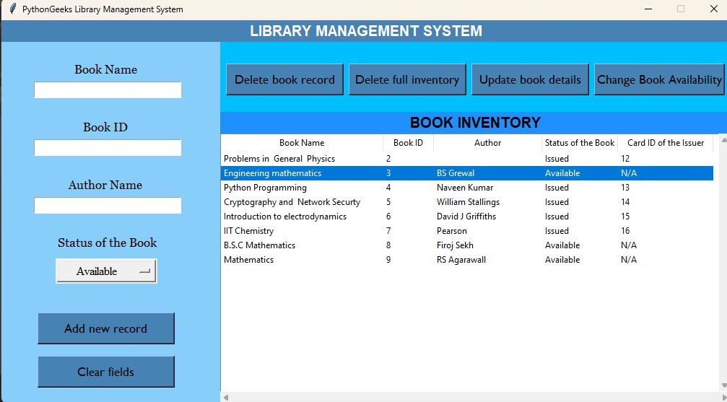
SYSTEM IMPLEMENTATION
Screenshot of performing operations in LMS

Slide 11

SYSTEM IMPLEMENTATION
CRUD OPERATION - Create

Slide 12
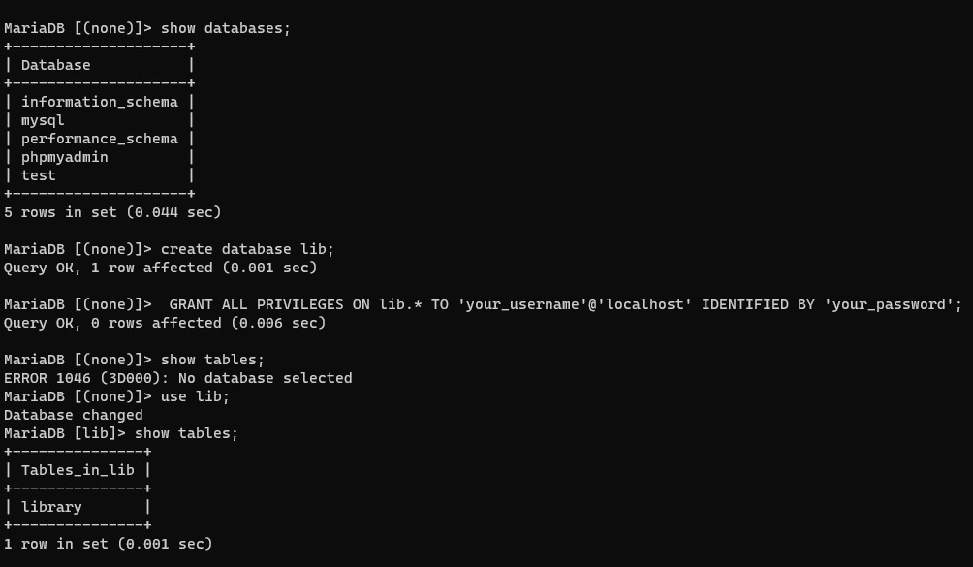
SYSTEM IMPLEMENTATION
CRUD OPERATION - Create

Slide 13
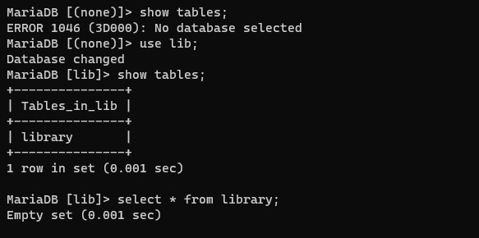
SYSTEM IMPLEMENTATION
CRUD OPERATION - Create

Slide 14
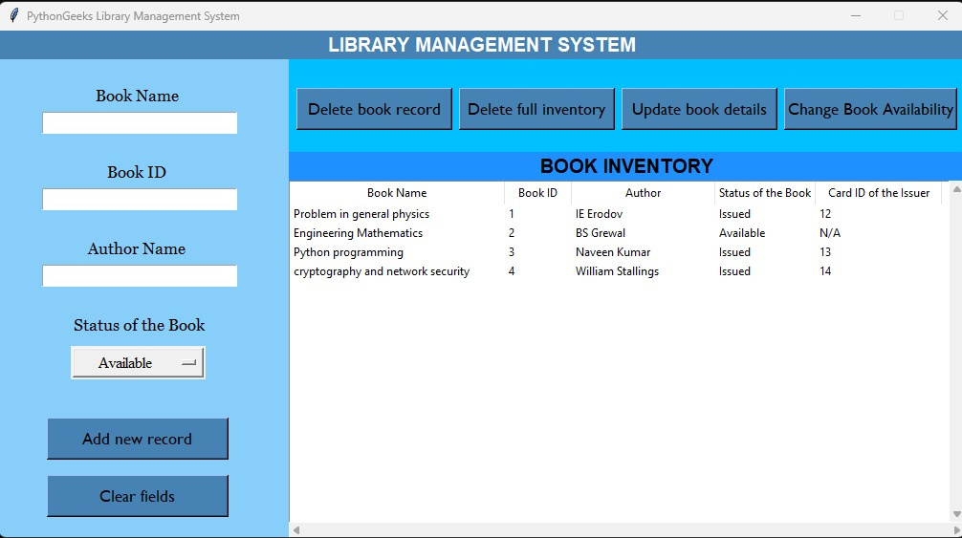
SYSTEM IMPLEMENTATION
CRUD - Read

Slide 15
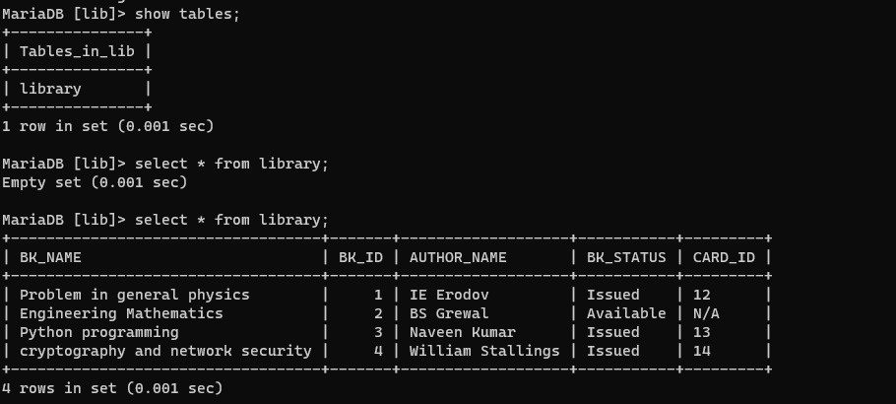
SYSTEM IMPLEMENTATION
CRUD - Read

Slide 16
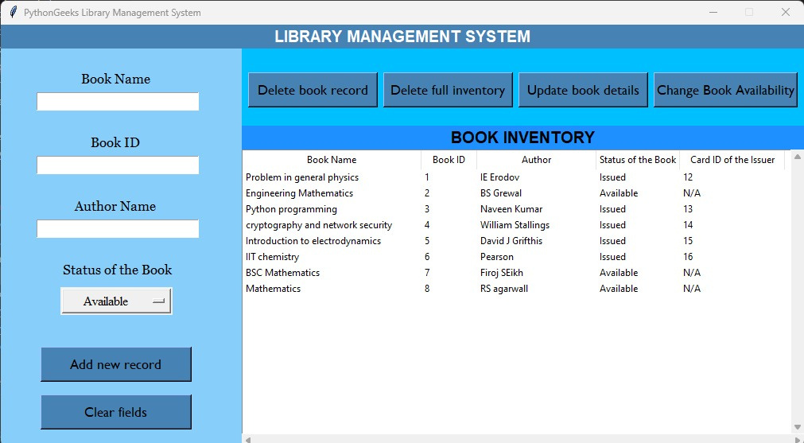
SYSTEM IMPLEMENTATION

Slide 17
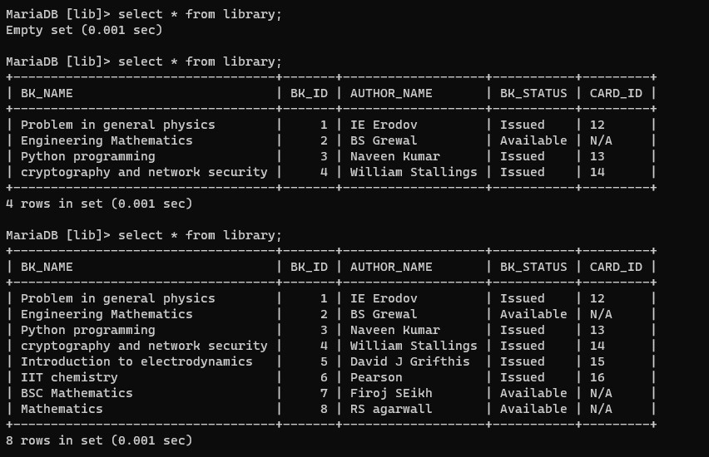
SYSTEM IMPLEMENTATION

Slide 18
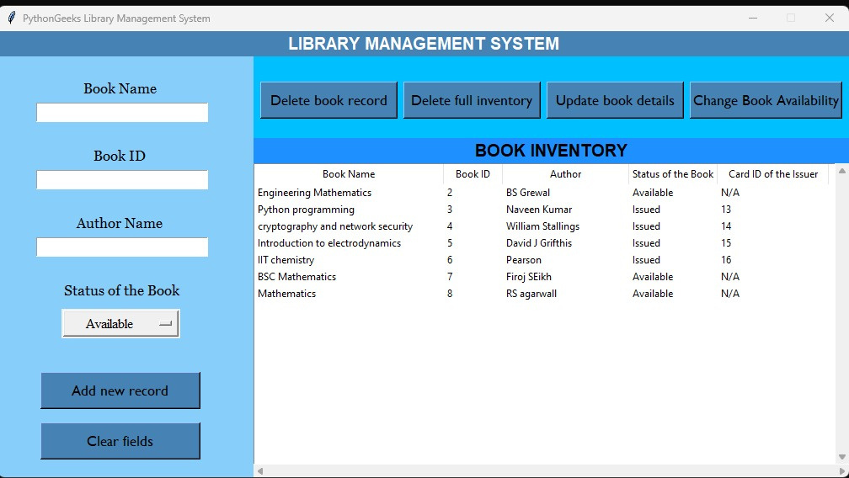
SYSTEM IMPLEMENTATION
CRUD - Delete
Deleted Book ID 1

Slide 19
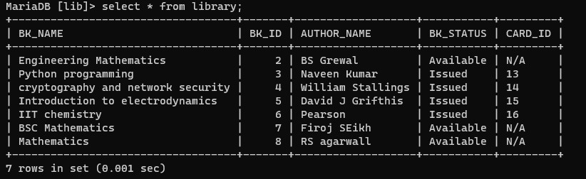
SYSTEM IMPLEMENTATION
CRUD - Delete
Deleted Book ID 1

Slide 20
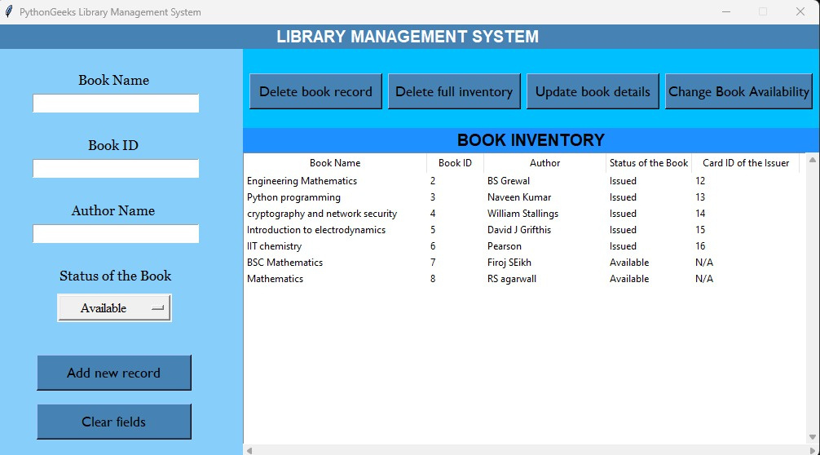
SYSTEM IMPLEMENTATION
CRUD - Update
Updated CARD ID

Slide 21
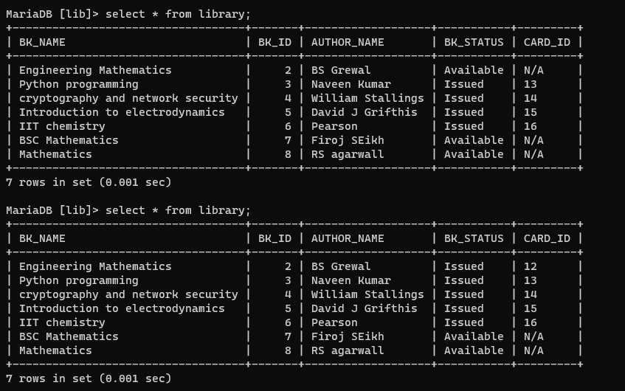
SYSTEM IMPLEMENTATION
CRUD - Update
Updated CARD ID

Slide 22
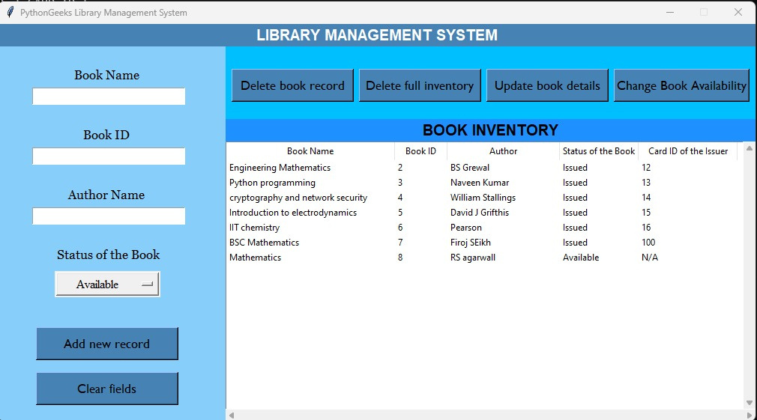
SYSTEM IMPLEMENTATION
Issuing & Returning Book
Book Name BSC Mathematics

Slide 23
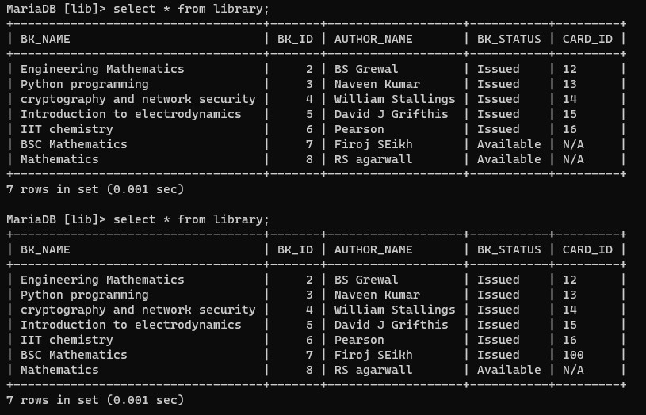
SYSTEM IMPLEMENTATION
Issuing & Returning Book
Book Name BSC Mathematics

Slide 24

SYSTEM IMPLEMENTATION
Deleted Full Inventry of Books

Slide 25
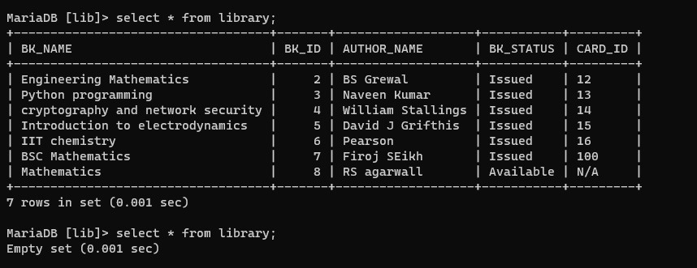
SYSTEM IMPLEMENTATION
Deleted Full Inventry of Books

Slide 26
FUTURE APPLICATION
Future LMS platforms may incorporate more immersive learning experiences, including virtual reality (VR) and augmented reality (AR), to provide realistic simulations and hands-on training. In the future, we can expect to see even more innovative approaches to learning, such as immersive learning experiences.

Slide 27
CONCLUSION
In conclusion, an LMS can help schools manage the educational process more efficiently, improve communication and collaboration, increase accessibility, and automate assessment.

Slide 28
﻿THANK YOU

